Slide 1


Title - NLP on Healthcare Reviews
Vasanthapriya R

Slide 2


NLP Based Healthcare Review Sentimental Analysis
Analyze sentiments in healthcare reviews
Tasks:
Data Preprocessing
Sentiment Analysis Model
Model Evaluation
Insights & Visualization

Slide 3
Problem Statement
Understanding user sentiment in healthcare reviews poses a challenge due to unstructured and noisy text data , varied expressions,language used and handling sarcasm or nuanced sentiments, imbalanced data. Extracting valuable insights from these diverse texts requires effective natural language processing techniques to decipher sentiment polarity accurately. Additionally, contextual understanding and ambiguous expression based on opinion or sentiment about a healthcare product, service, or experience. Handling positive, negative, neutral language further complicates sentiment analysis. Model building based on sentimental analysis and insights gained from results.

Slide 4
Objective
The goal of this project is to develop a model that can classify sentiments in healthcare reviews. This involves analyzing text data from healthcare reviews and determining whether the sentiment expressed in each review is positive, negative, or neutral.

Slide 5
Motivation
Data Preprocessing: This task involves cleaning and preparing the text data from healthcare reviews. It includes tasks like text tokenization, removing stop words, and handling any missing data.
Sentiment Analysis Model: Develop a machine learning or natural language processing (NLP) model that can classify sentiments in healthcare reviews. This model should be able to categorize reviews as positive, negative, or neutral based on the text content.
Model Evaluation: Assess the performance of the sentiment analysis model using appropriate evaluation metrics. This step is crucial to ensure the model's accuracy and effectiveness.
Insights & Visualization: After building and evaluating the model, generate insights from the sentiment analysis results. Visualize the data and findings to communicate the results effectively.

Slide 6
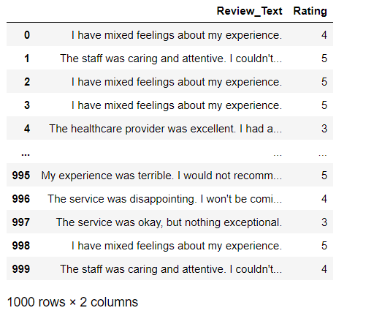
Dataset
Dataset comprises 1000 rows, split into 800 training and 200 testing rows.
Entries include fields like review and rating
Review - Each review is a piece of text that expresses an opinion or sentiment about a healthcare product, service, or experience
Rating – 1 to 5 rating of the healthcare review
Structured for healthcare reviews analysis and usefulness of reviews.

Slide 7
Method
Data Collecting : Collect data into a structured format such as CSV
Data Preprocessing: Handling Null values , Text pre-processing like Converting text to lowercase, Removing special characters, Tokenize text, Stop words removal, Lemmatization, Stemming, Pos tagging, Polarity and oversampling based on the count .
Model Training: Train models on Healthcare review data for sentiment analysis.
Model Fusion/Ensemble: Combine predictions from Logistic Regression, Naive Bayes, Support Vector Machines (SVM) models.
Evaluation Metrics: Assess performance using accuracy, precision, recall, F1-score, and confusion matrix
Fine-tuning and Optimization: Refine models based on results, tuning hyperparameters for better performance by cross validation

Slide 8
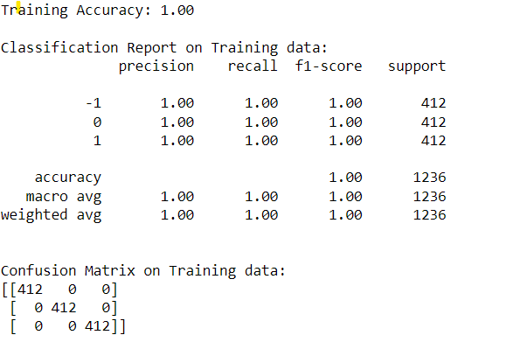
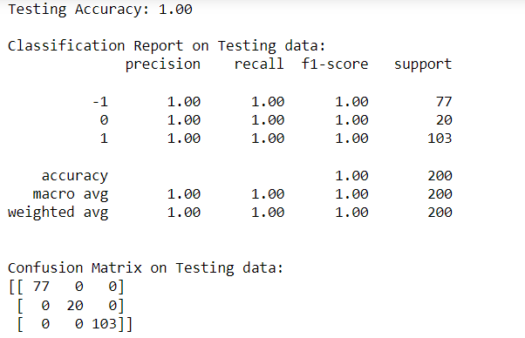
Model Description – Logistic Regression
Its an supervised machine learning algorithm that accomplishes binary classification tasks by predicting the probability of an outcome, event, or observation. The model delivers a binary outcome limited to two possible outcomes: yes/no, 0/1, or True/false..
Prediction of Training Set - 800 Sample Testing Set – 200 sample

Slide 9
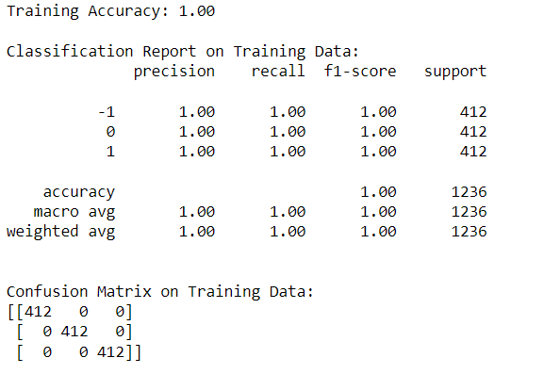
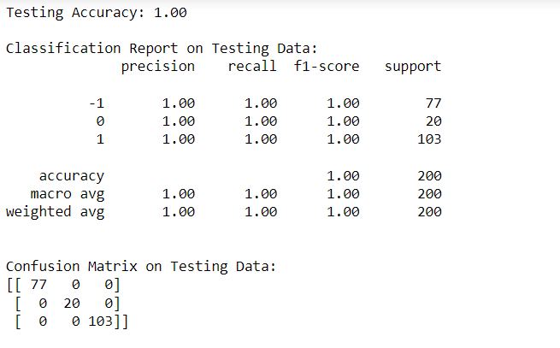
Model Description – Multinomial Naives Bayes
Its an supervised machine learning algorithm used for classification tasks such as text classification. Naive Bayes classifier assumes that the presence of a particular feature in a class is unrelated to the presence of any other feature and most of the classification technique based on Bayes’ Theorem with an independence assumption among predictors.
Prediction of Training Set - 800 Sample Testing Set – 200 sample

Slide 10
Model Description – Support Vector Machine
Its an supervised machine learning problem where we try to find a hyperplane that best separates the two classes and is based on statistical approaches. It works best when the dataset is small and complex.
Prediction of Training Set - 800 Sample Testing Set – 200 sample

Slide 11
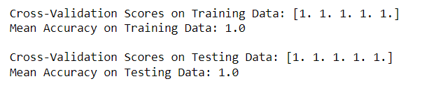
Cross Validation
When we check all models achieved perfect accuracy on the training and testing data, with precision, recall, and F1-score all equal to 1.0 for each class. The confusion matrix also indicates that the model made correct predictions for all instances in the training set. So we cross validate for the same level of performance on new, unseen data, leading to Overfitting.
Overfitting is when a model performs exceptionally well on the training set but fails to generalize to new instances So performing the following steps to handle overfitting: Cross-validation
Output

Slide 12
Why do we need Cross-Validation
Suppose we build a machine learning model to solve a problem, and we have trained the model on a given dataset. When we check the accuracy of the model on the training data, it is close to 95%. Does this mean that our model has trained very well, and it is the best model because of the high accuracy.
No, it’s not! Because our model is trained on the given data, it knows the data well, captured even the minute variations(noise), and has generalized very well over the given data. If we expose the model to completely new, unseen data, it might not predict with the same accuracy and it might fail to generalize over the new data. This problem is called over-fitting.
Sometimes the model doesn’t train well on the training set as it’s not able to find patterns. In this case, it wouldn’t perform well on the test set as well. This problem is called Under-fitting.
To overcome over-fitting problems, we use a technique called Cross-Validation.

Slide 13
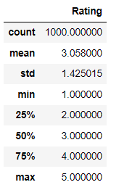
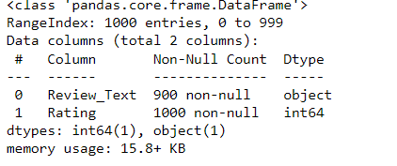
Implementation
Statistical Description
Information Reg Data

Slide 14
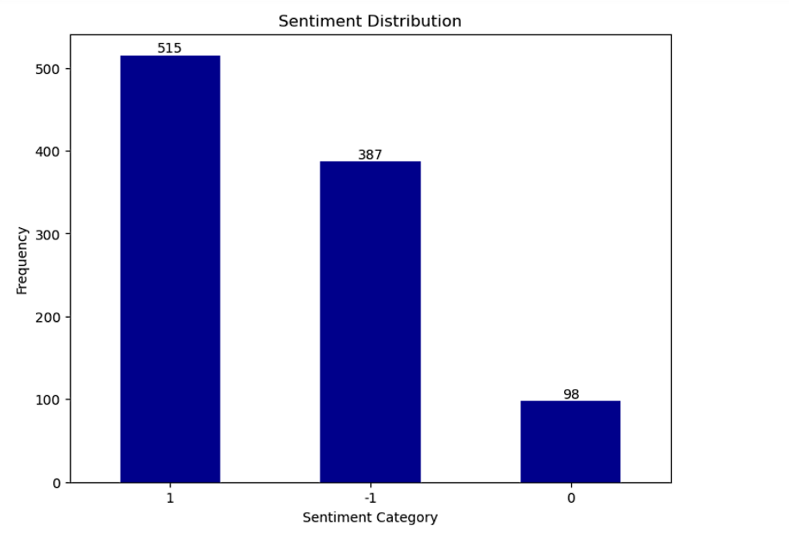
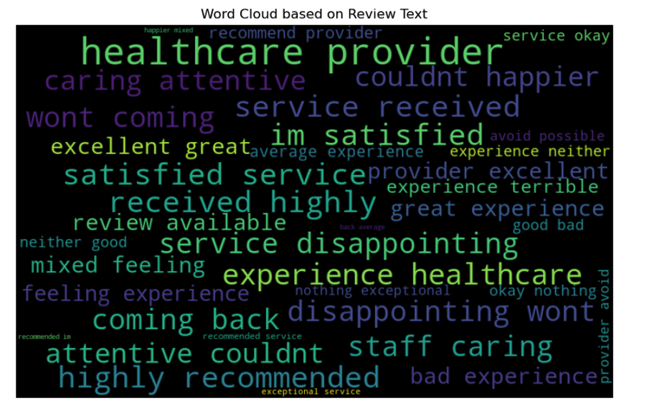
Implementation
Sentimental Category Distribution
Word Based on Review Text

Slide 15
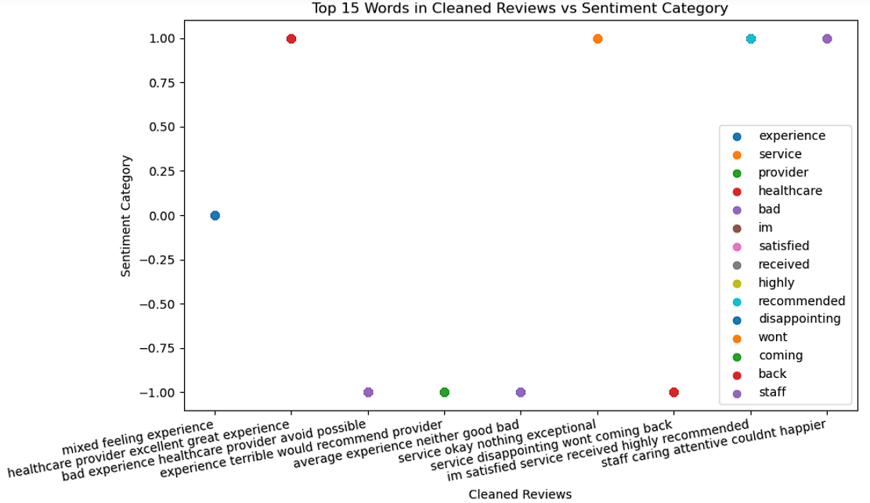
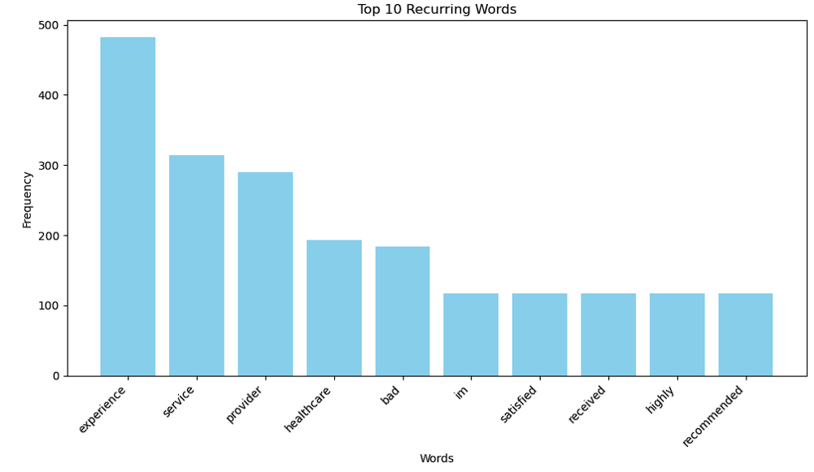
Implementation
Top 15 Words in Cleaned Review Top 10 Recurring Words
From the above Bar chart we identify Experience has highest Recurring words and From Scatter plot we see positive words like Healthcare and Negative Staff and Neutral experience has top 15 words.

Slide 16
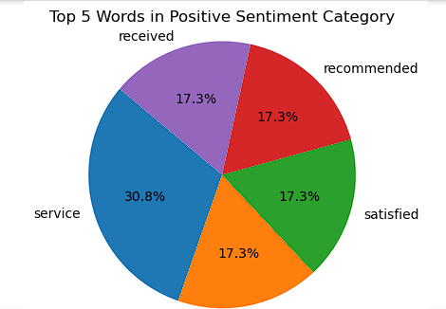
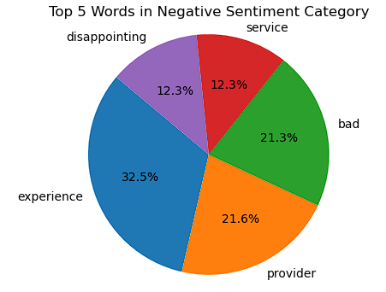
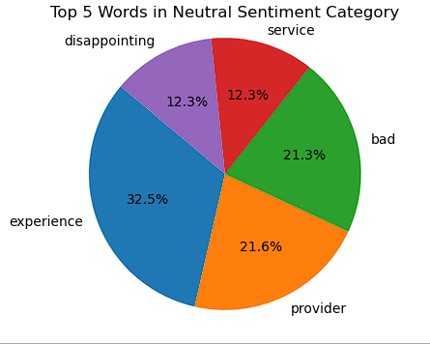
Implementation
Positive Negative Neutral
The Above pie chart represent the Positive , Negative , Neutral top 5 words . Service is most positive and leads, rest words with similar satisfaction . Experience is top on both Negative and Neutral and service is the least among rest of the words.

Slide 17
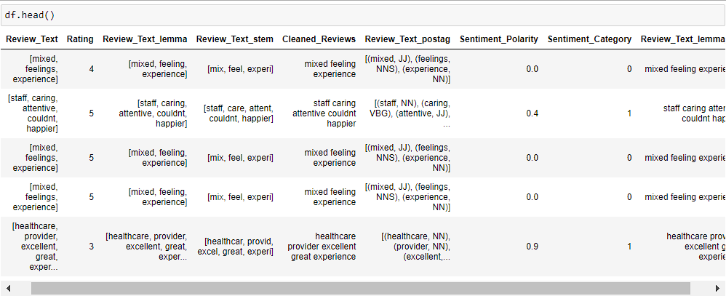
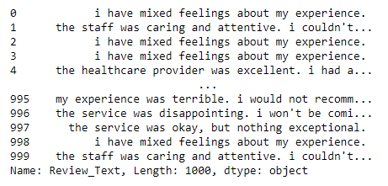
Implementation
Data Before Cleaning
Data After Cleaning

Slide 18
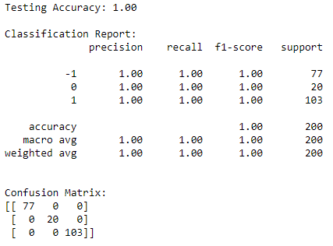
Implementation
Accuracy: Model's overall accuracy on the testing data is perfect, with 100% correct predictions, approximately 1%.
Confusion matrix: Shows true/false positives/negatives.
Precision: Accuracy of positive class predictions.
Recall: Fraction of actual positives predicted correctly.
F1-score: mean of precision and recall.
Support: Number of occurrences for each class and reliability of the metrics
Macro and weighted averages: Overall evaluation metrics
Classification Report

Slide 19
Future Implications & Challenges & Recommend
Future :
Refine Healthcare insights through Sentimental Analysis.
Extend Sentimental Analysis impact across diverse industries
Challenges :
Overcome biases inherent in user-generated sentiment.
Adapt models for analysis precise sentiment classification in varied reviews.
Recommendation :
The model work well on both testing and training dataset.
Top 10 recurring words indicates a positive review and response towards healthcare services.
Handling imbalanced dataset.

Slide 20
Insights
Training Data
-The models have achieved perfect accuracy on the training set, as evidenced by the training accuracy of 1.00.
-The classification report and confusion matrix suggest that the model is making correct predictions for each class, with precision, recall, and F1-score all equal to 1.00
Testing Data
-The model achieved perfect accuracy on the test set, which aligns with the results on the training set.
-The classification report and confusion matrix suggest that the model is making correct predictions for each class, with precision, recall, and F1-score all equal to 1.00.
Cross-Validation of Models
-All individual cross-validation accuracy scores on the training and testing data are 1.0 (100%). This suggests that, in each fold, the model achieved perfect accuracy on the training and testing data.
-The mean accuracy on the training and testing data is also 1.0, indicating that the model consistently performed well across different subsets of the training and testing data during cross-validation
Positive Reviews : Customers are highly satisfied and recommend the service.
Negative Reviews : Customers had a bad, disappointing experience and service.
Neutral Reviews : Customers had a bad, disappointing experience and service.

Slide 21


